Slide 1
Portfolio
Jenny Papworth
Application to Foundation Diploma in Art and Design
University for the Creative Arts

Slide 2
Drawing
Pen and Ink Brighton Pavilion
        Venice
Pencil Glass of Water
Spoon
Pastel Nectarines
White Jug
Daffodil Head
Apples

Slide 3
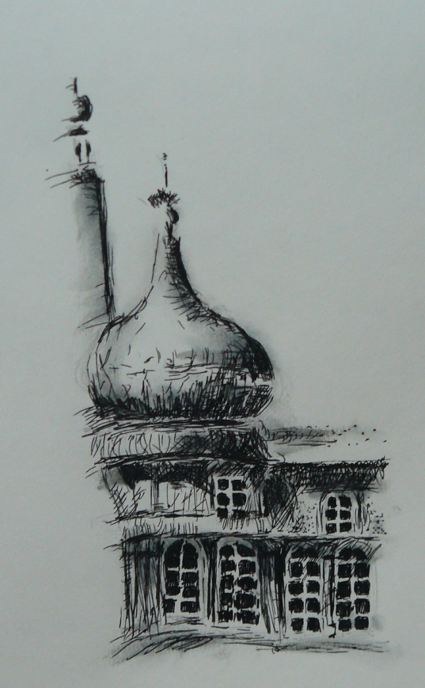
Brighton Pavilion (detail)

Slide 4
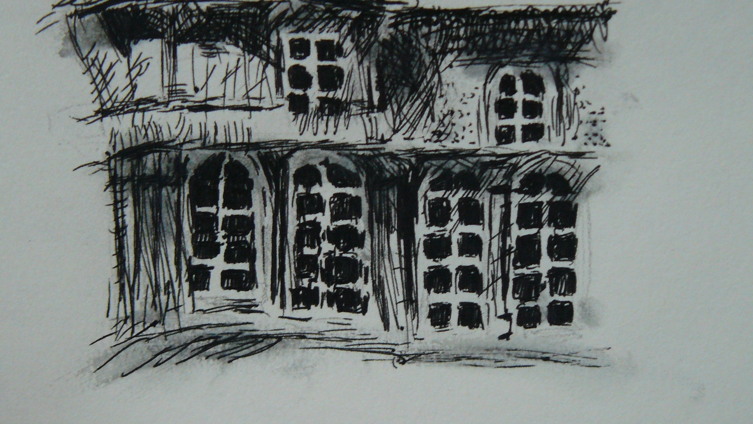
Brighton Pavilion
Detail

Slide 5
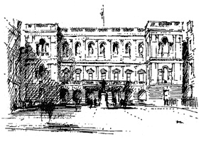
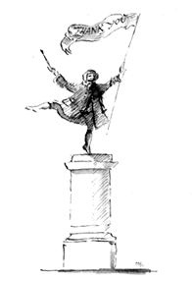
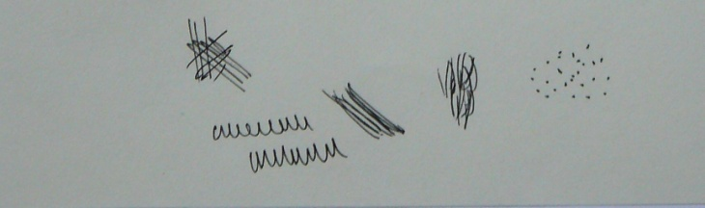
I try to use an extensive range of marks: hatching, obliques, and various dashes and dots (see below).
I like to use a wide tonal range; I built up marks to create an intense black in some areas and intentionally leave other areas bare. The contrast makes the drawing striking; the white of the page makes the built up areas appear even darker and the dark areas highlight the blankness of the page.
My style of drawing has been influenced by the work of Sir Hugh Casson. In this piece I have tried to emulate some of Casson’s techniques - his use of oblique (above right) and his technique of smudging the ink with water - while maintaining a strong sense of my own style.
Right: Sir Hugh Casson,
Pen and ink
Above right: Sir Hugh Casson,
Pen and ink
Left: examples of pen marks used
in ‘Brighton ‘Pavilion’

Slide 6
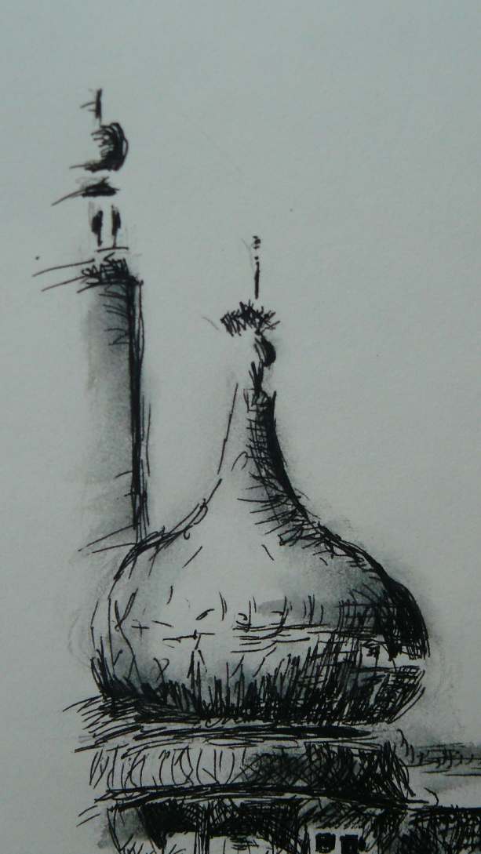
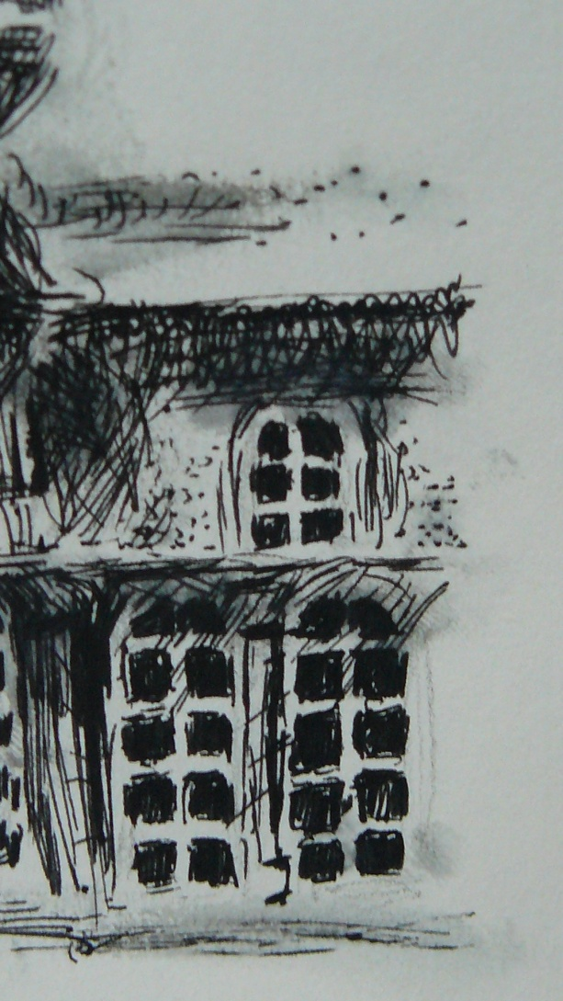
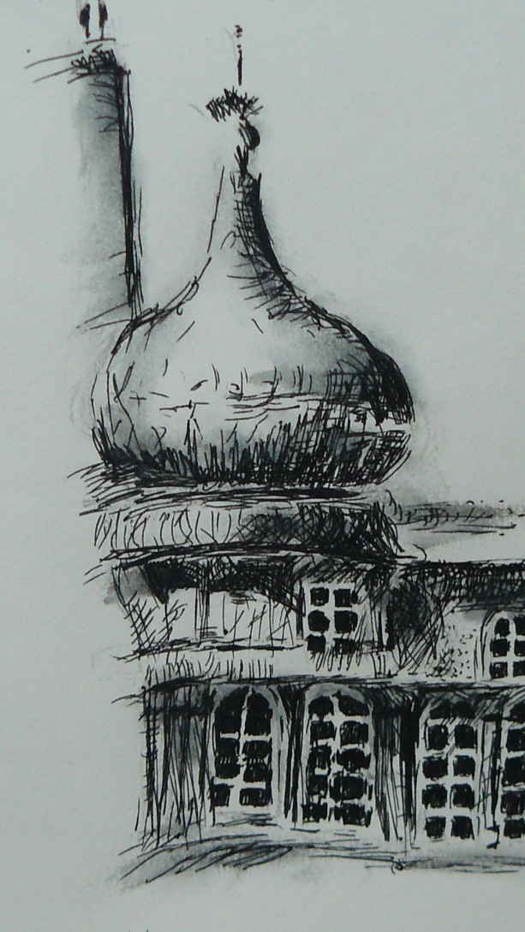
Details of ‘Brighton Pavilion’ showing the techniques I have used

Slide 7
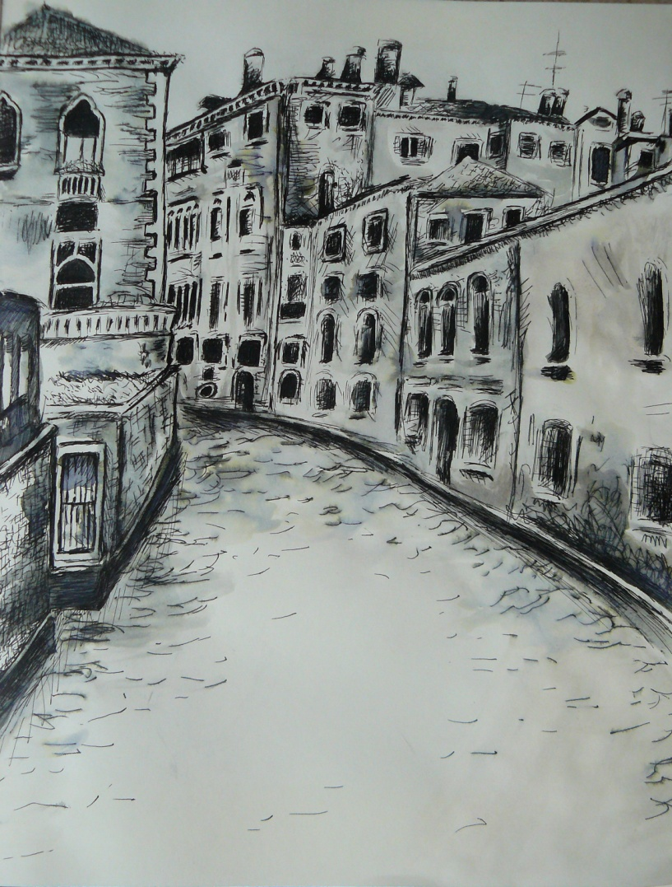
Venice
Pen and ink, water

Slide 8
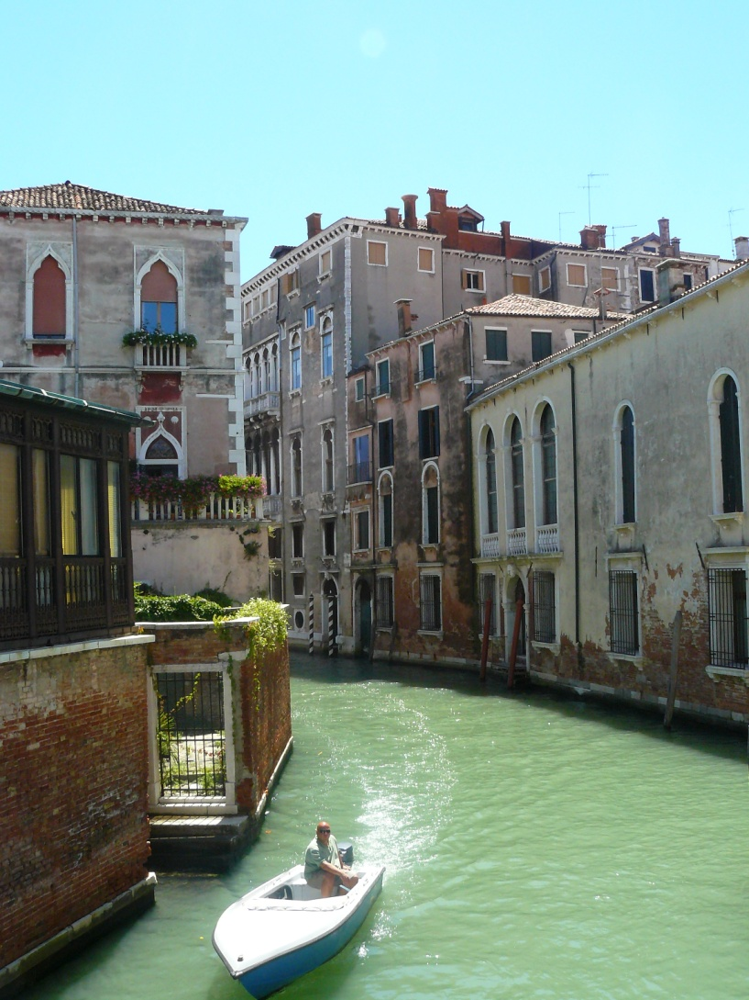
Venice
The original photograph

Slide 9
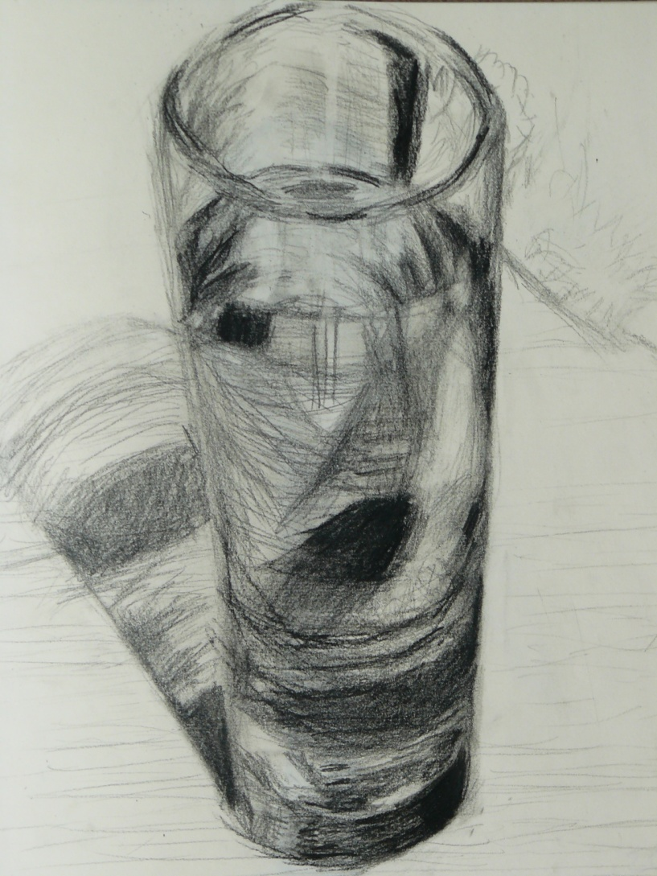
Glass of Water
Daler-Rowney Artists Pencils in ‘Black Drawing’ and Black Smooth’

Slide 10
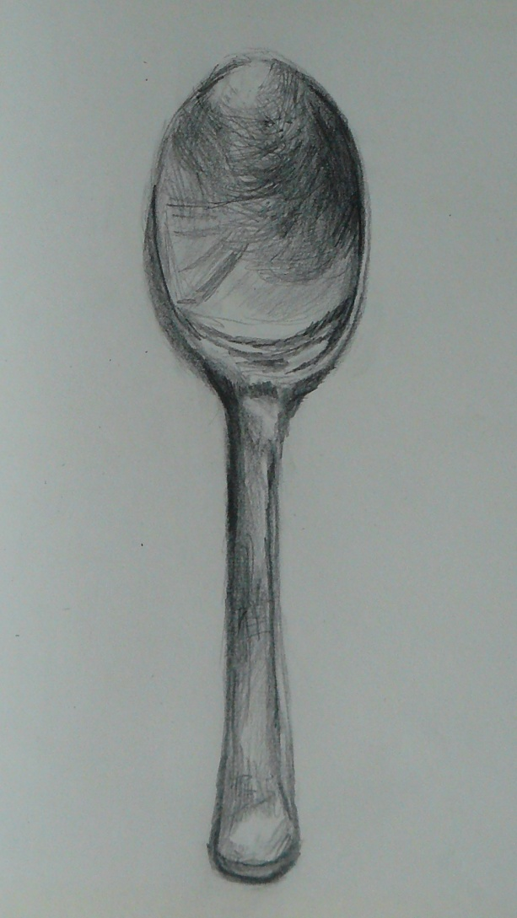
Spoon
2b pencil

Slide 11
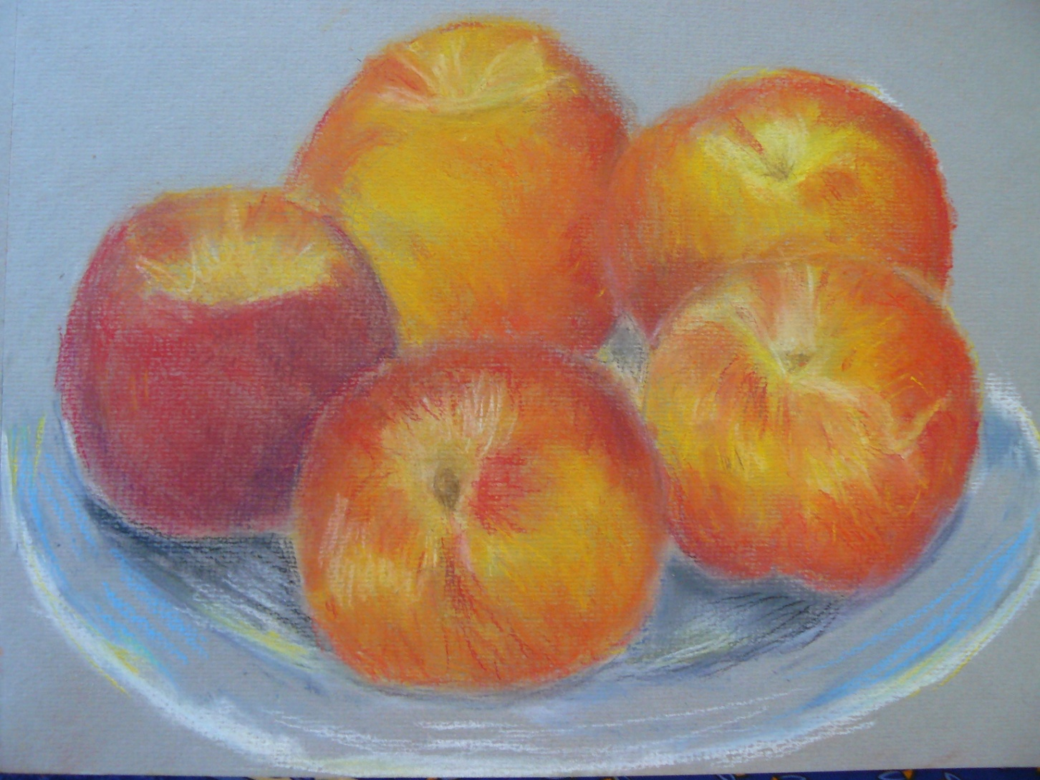
Nectarines soft pastel

Slide 12
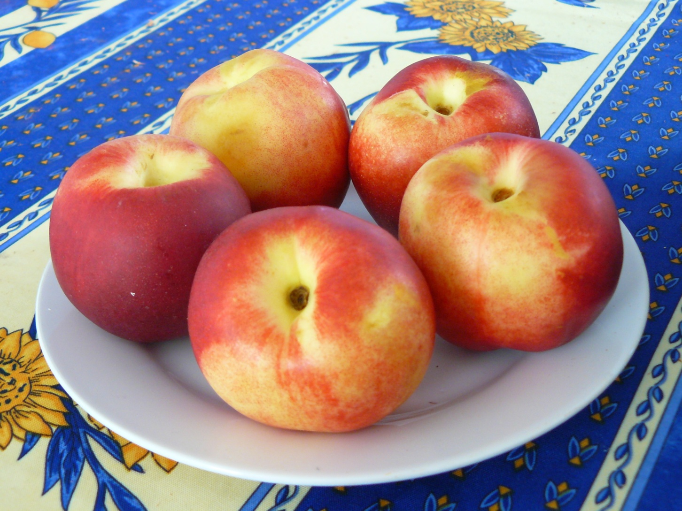
Nectarines original photograph

Slide 13
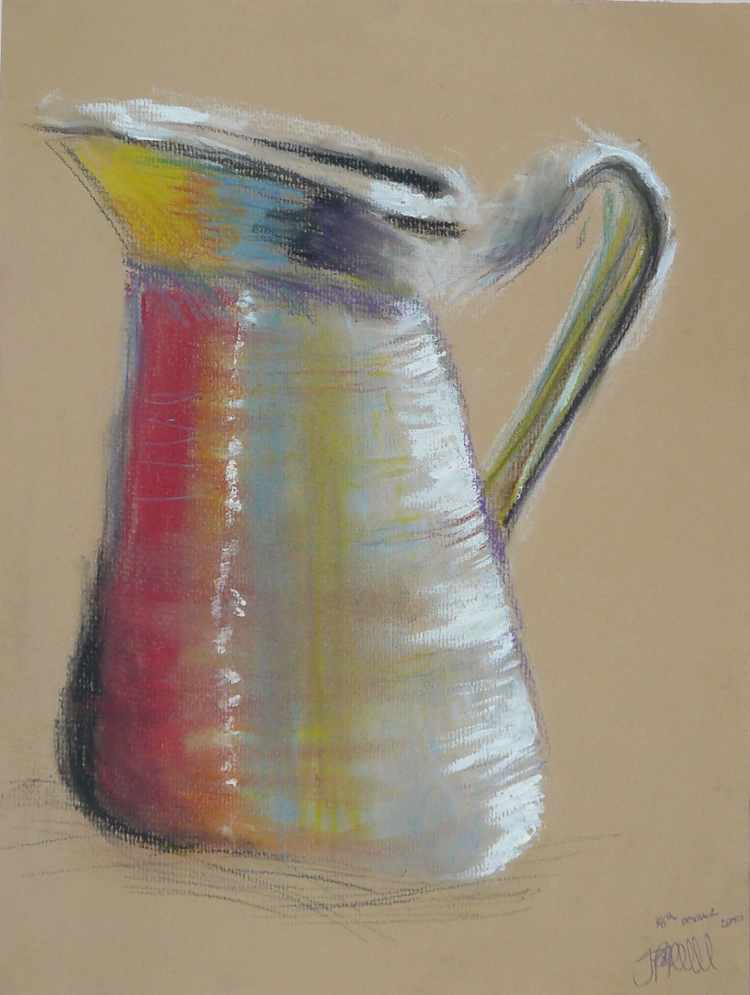
White Jug soft pastel and white acrylic

Slide 14
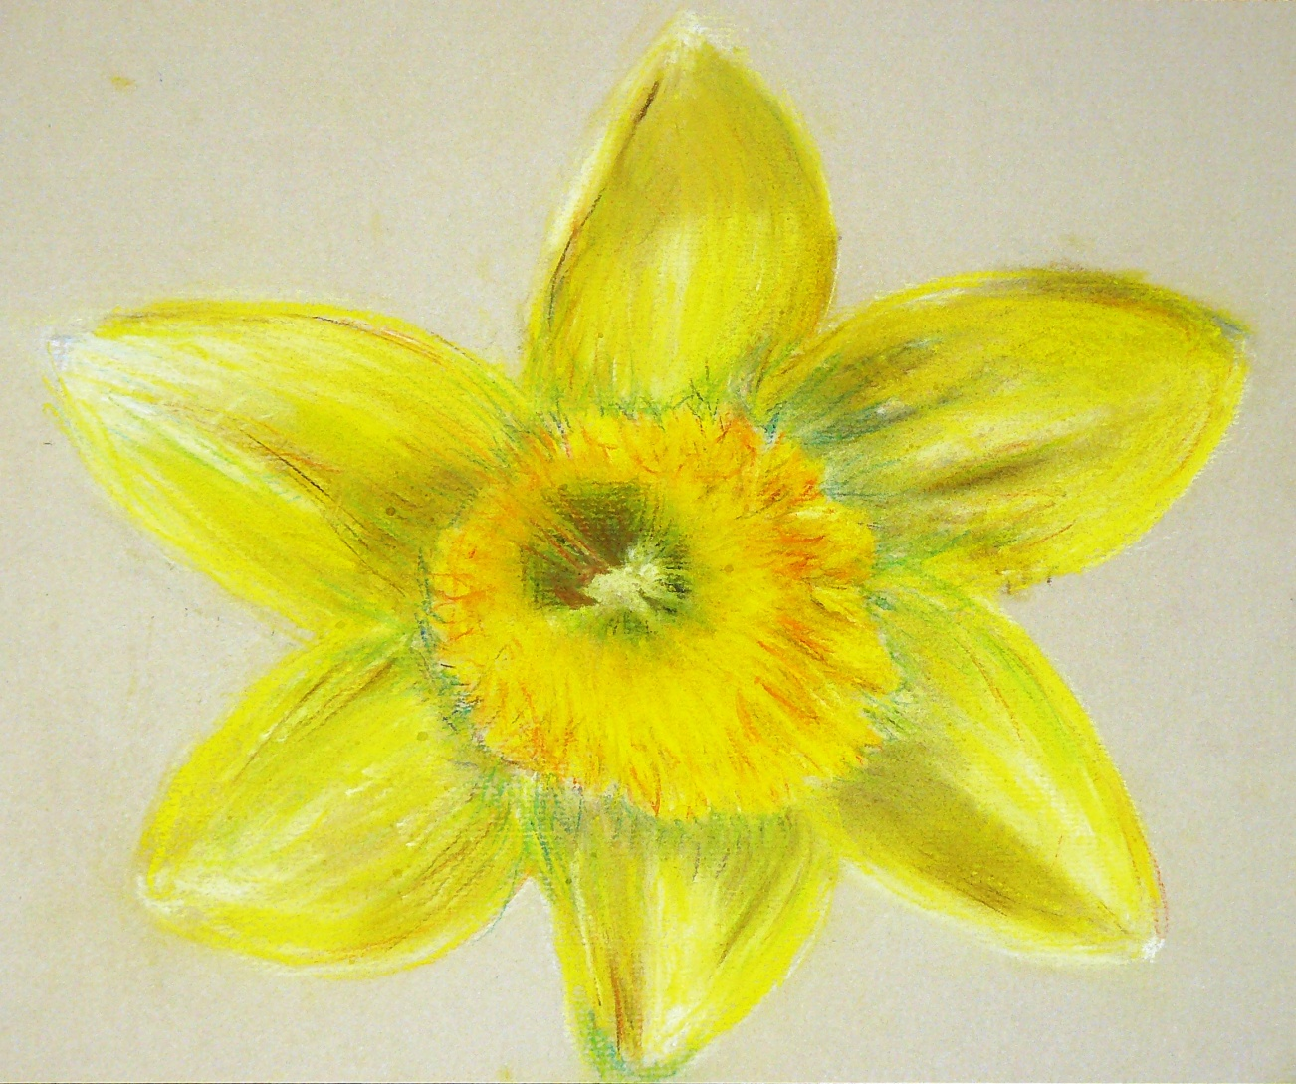
Daffodil Head soft pastel

Slide 15
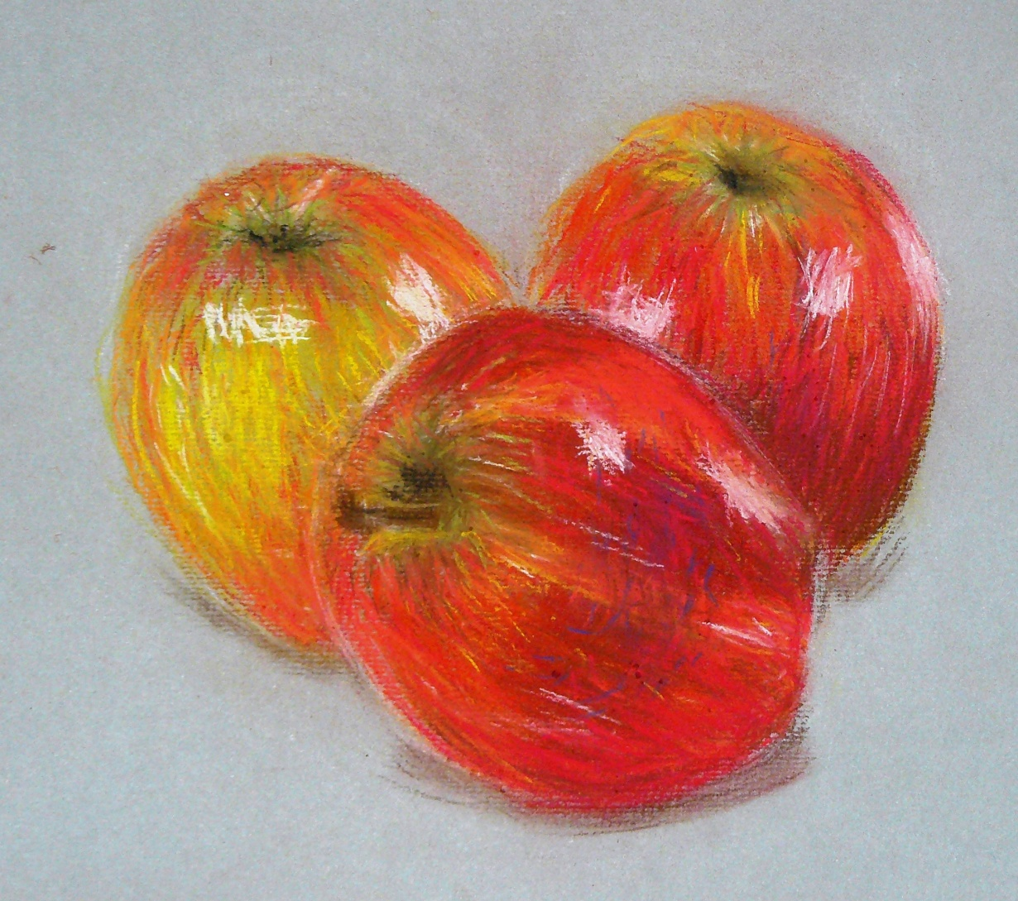
Apples soft pastel

